Slide 1
Hiring Process Analytics Statistics

Slide 2
PROJECT DESCRIPTION
The project is about analyzing company’s hiring process & draw meaningful insights from the data.
The hiring process is important function for a company and understanding the trends such as no . of rejections , jobs offered , offered salaries to provide valuable insights.
The project data is given excel sheet ,it should be preprocessed before using.

Slide 3
TECH STACK USED
SOFTWARE:
EXCEL:
Excel is a powerful spreadsheet software used for data analysis, calculations, and visualization.
It allows users to create the table, charts, and graphs to organize and present data.
Excel has formulas, functions
It is widely used in finance, business, research, and education for managing large datasets

Slide 4
APPROACH
DATA PREPROCESSING:
The team has given the dataset(excel) with name Statistics.
The given data was not cleaned and preprocessed,that means it is not ready to analyze and make insights.
So we need to start the project by Cleaning the Dataset.
Firstly I made the table by using the data columns provided,then checked for blank values in each column.

Slide 5
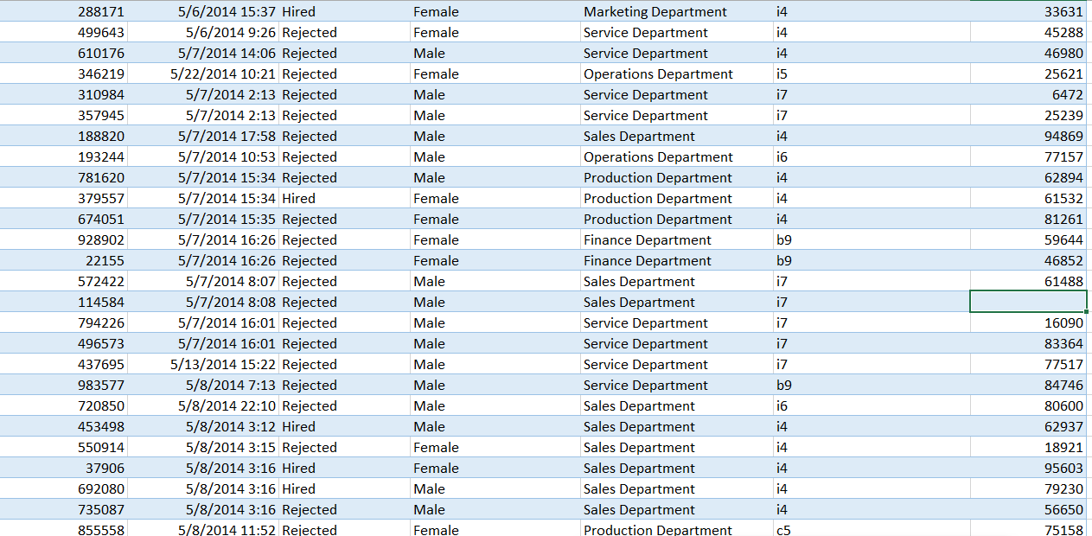
Created the table:

Slide 6
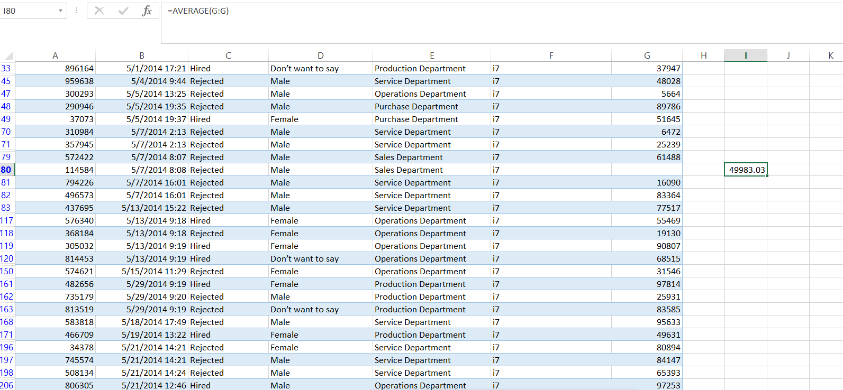
I Checked all columns by setting filters as blanks ,found a blank in offered Salary at (G80) row.
Inserted the average(mean) value as per post name.
Changed the column name from event_name to Gender to give proper understanding of data by the readers.

Slide 7
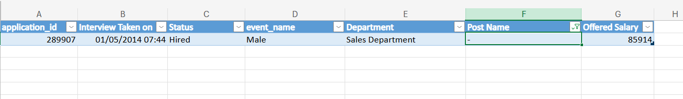
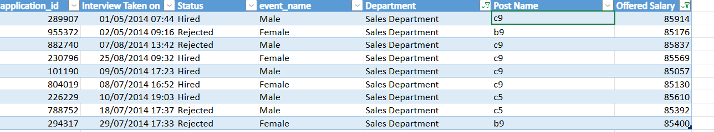
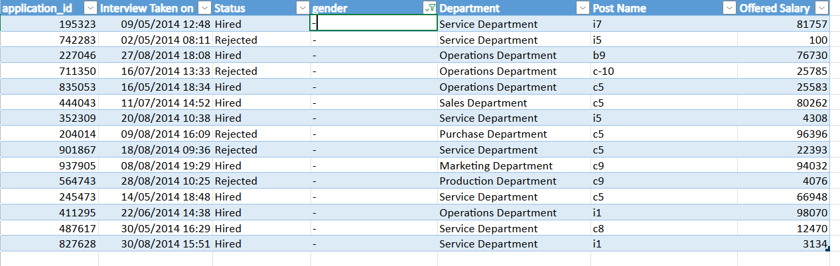
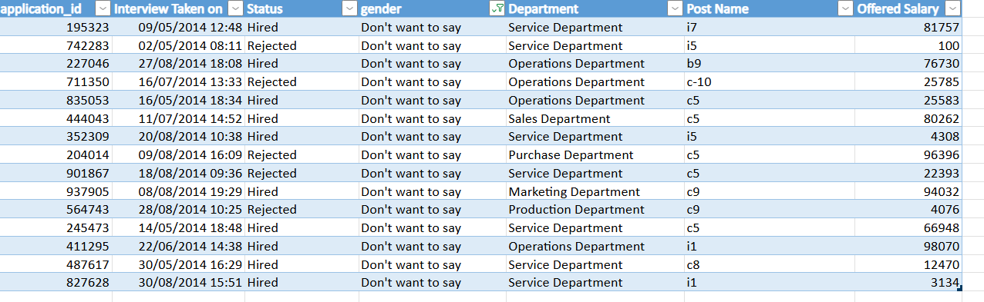
In post name column I found a hyphen so in order to fill it filtered the department name as Salesdepartment,set a filter for salary offered and took the mode of the postname.
Changed the event_name column name as gender and changes the hyphen as Don’ t want to say.

Slide 8
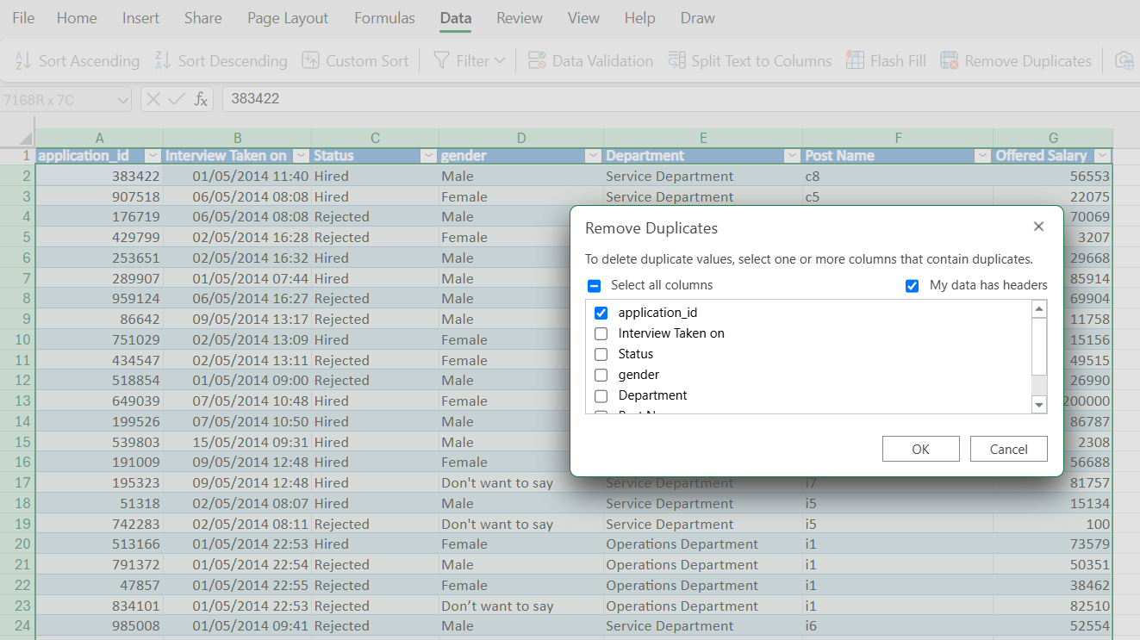
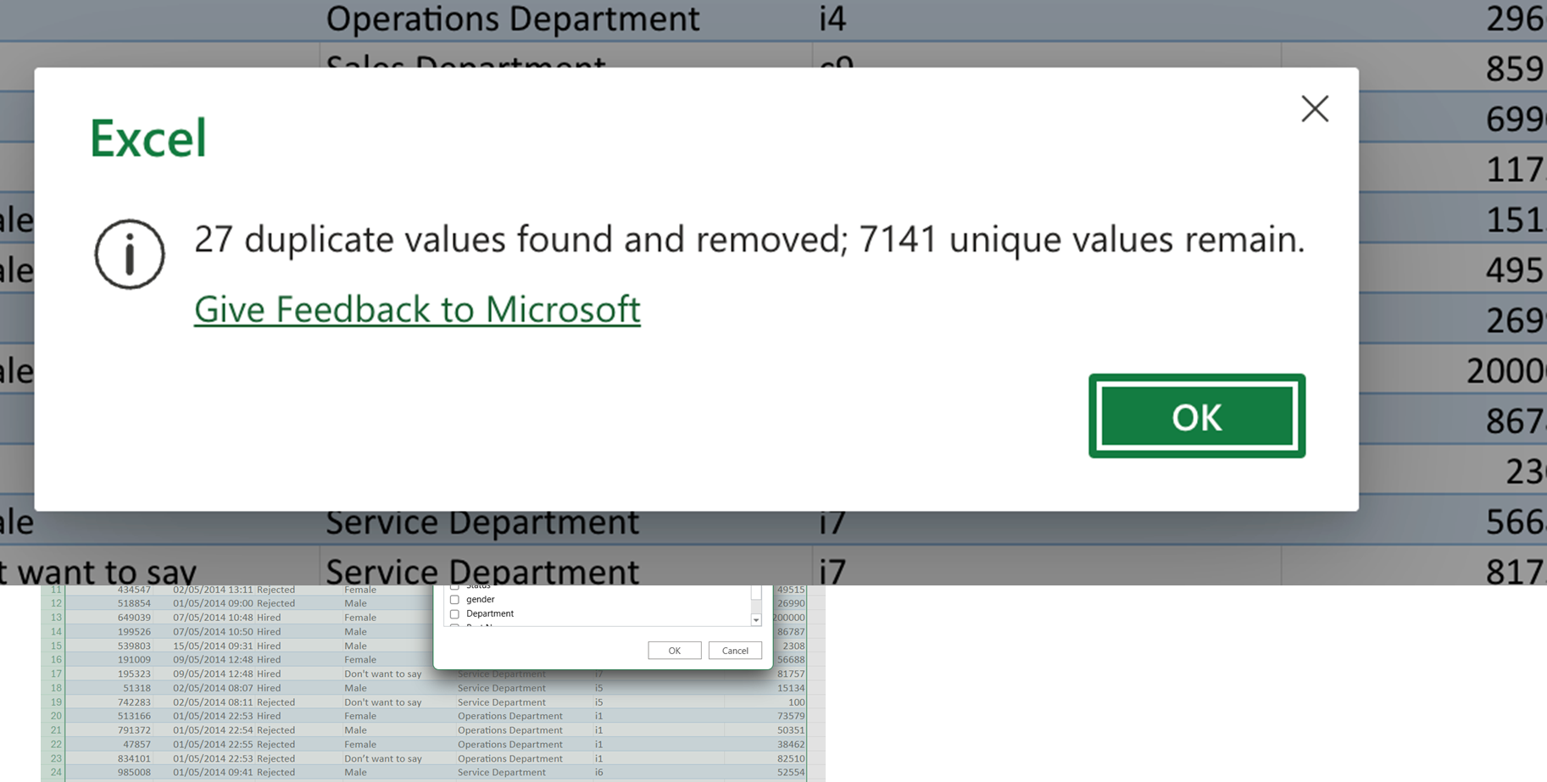
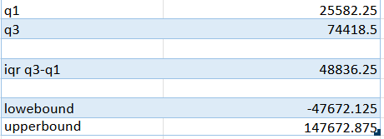
The application should be unique so delete the duplicates.
OUTLIER DATA DETECTION & REMOVAL:
To detect the outlier data
Q1: =quartile(range,1)
Q2: =quartile(range,2)
Q3: =quartile(range,3)
IQR: =Q3-Q1
Lower bound: Q1-(1.5*IQR)
Upper bound: Q3+(1.5*IQR)
After calculating lower and upper bound,we should check the outlier data by condition,and delete the outlier rows.

Slide 9
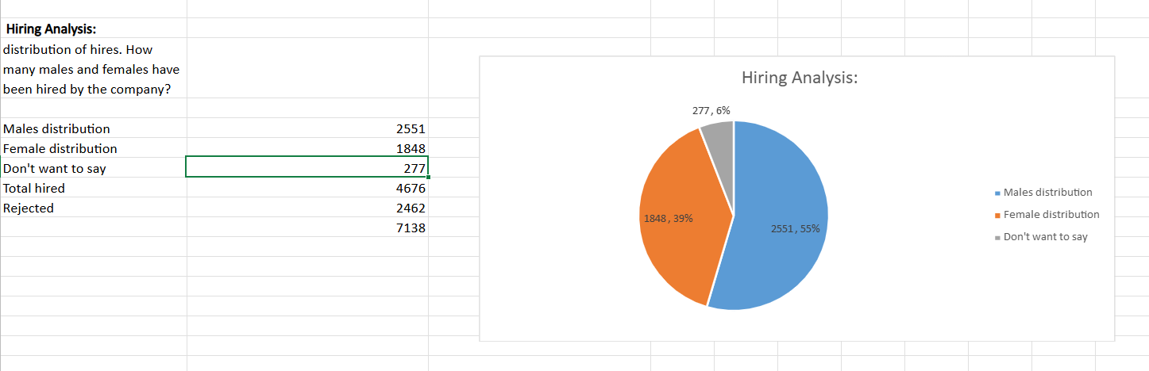
Data Analytics Tasks
A. Hiring Analysis: The hiring process involves bringing new individuals into the organization for various roles.
Task: Determine the gender distribution of hires. How many males and females have been hired by the company?

Slide 10
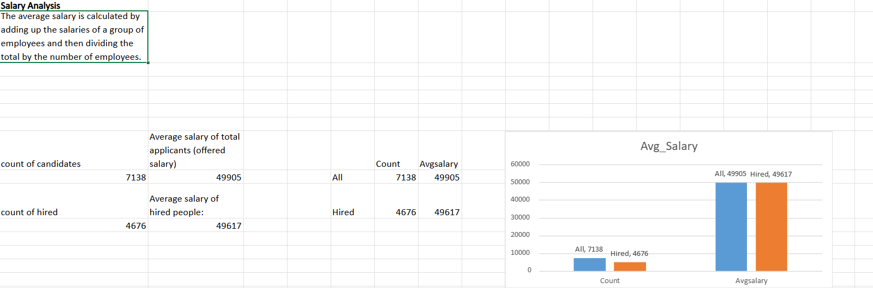
Data Analytics Tasks
B. Salary Analysis: The average salary is calculated by adding up the salaries of a group of employees and then dividing the total by the number of employees.
Task: What is the average salary offered by this company? Use Excel functions to calculate this.

Slide 11
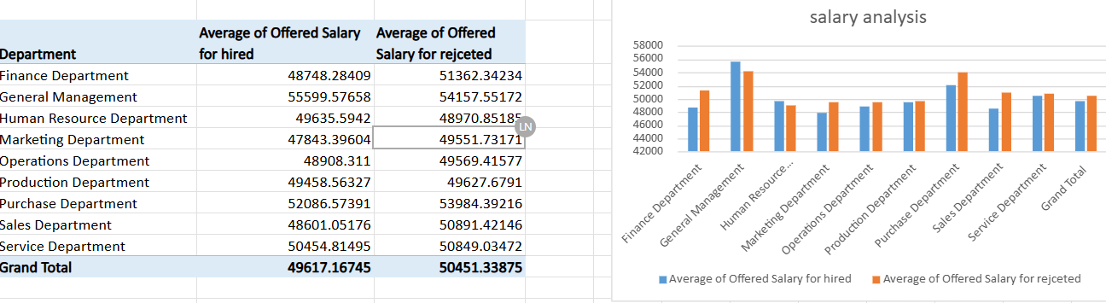

Slide 12
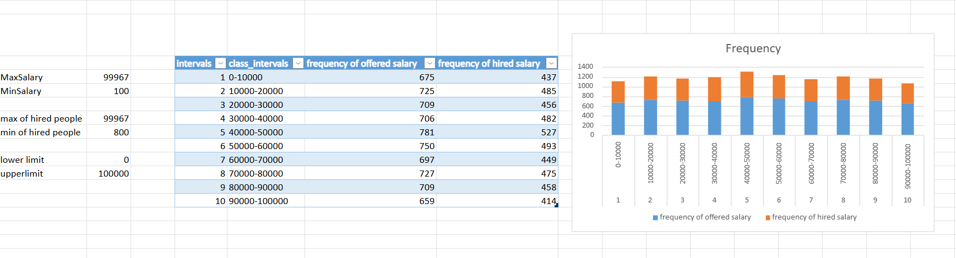
Data Analytics Tasks
C. Salary Distribution: Class intervals represent ranges of values, in this case, salary ranges. The class interval is the difference between the upper and lower limits of a class.
Task: Create class intervals for the salaries in the company. This will help you understand the salary distribution.

Slide 13
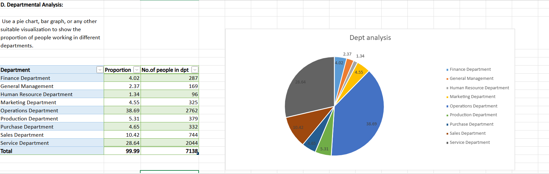
Data Analytics Tasks
D. Department Analysis: Visualizing data through charts and plots is a crucial part of data analysis.
Task: Use a pie chart, bar graph, or any other suitable visualization to show the proportion of people working in different departments.

Slide 14
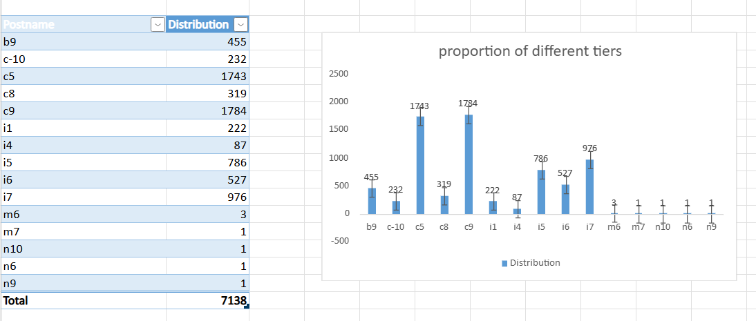
Data Analytics Tasks
E. Position Tier Analysis: Different positions within a company often have different tiers or levels.
Task: Use a chart or graph to represent the different position tiers within the company. This will help you understand the distribution of positions across different tiers.

Slide 15
INSIGHTS
Gender Distribution: If more men or women are hired, the company may need to improve diversity in hiring the employees.
Average Salary: Less salaries can lead to employees leaving the company, while very high salaries may affect company costs.
Salary Distribution: If more employees earn lower wages, there may be limited growth opportunities.
Departmental Distribution: Some departments may need more hiring, while others may be overstaffed.
Position Tier Analysis: If there are too few mid or senior-level employees, it may show a lack of promotions or leadership development in the company.

Slide 16
CONCLUSION
Excel is a powerful tool for data analysis, making it easy to preprocess & clean , organize, and visualize the large datasets.
Its built-in functions, pivot tables, and charts help draw meaningful insights quickly& effectively . With automation through formulas and macros, Excel streamlines complex tasks efficiently.
Reference link:
https://docs.google.com/spreadsheets/d/1Ua6iLm08SoA7wKqGp8Qj91O-nZz7QPGW/edit?usp=sharing&ouid=113127512394157800809&rtpof=true&sd=true
Thank you

